Slide 1
Tech Day 2017
21st Century Skills:
Using technology for critical thinking, collaboration,
communication, and creativity in the classroom

Slide 2
Story Jumper
Tutorial
https://www.youtube.com/watch?v=DPRjr2aijzM

Slide 3
Story Jumper Ideas
Science: A Dog’s Digestive System

Slide 4
Story Jumper Ideas
Art analysis of famous artists or a collection of pictures of student’s own artwork

Slide 5
Story Jumper Ideas
A Dictionary of Math Terms

Slide 6
Story Jumper Ideas
A book about Mariachi music for music class

Slide 7
Story Jumper Costs
Usage is free
Publishing options
$24.95 hardcover
$12.95 softcover
$2.95 unlimited color printing from computer
Black and white printing from computer is free
Share digitally

Slide 8
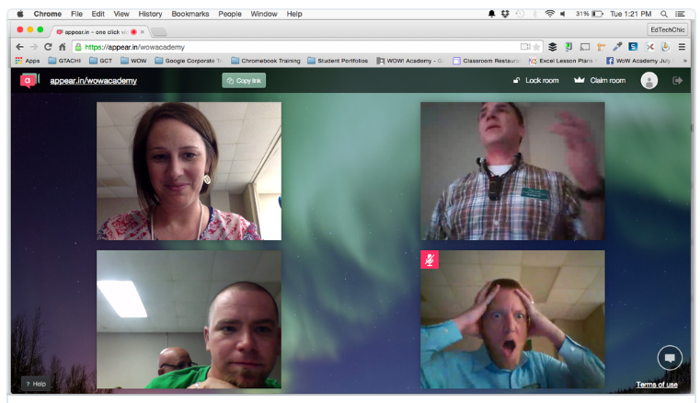
Appear.in
Created by a company in Oslo, Norway
Video conversations with up to 8 people
No downloads
Create a video room
Share the link
Appear together

Slide 9
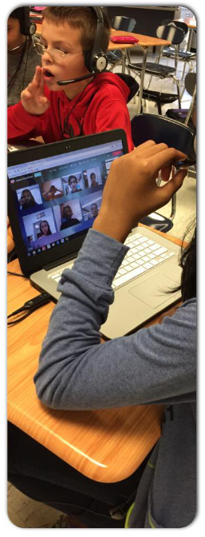
appear.in at school
appear.in lets you communicate in the most natural way; seeing the person you're talking to, hearing their voice and taking in all their body language.
https://www.youtube.com/watch?v=yl-bTXwV_Kk

Slide 10
Uses for the Classroom
Talking to students in another country in language class
Playing Kahoot! quizzes with other classes
Allowing students to call into class when they're not able to get to school (because of illness, disabilities, snow, etc.)
Tutoring students when they're home
Meeting with students and parents
Communicating with students during group tasks or projects, where students work in different rooms around school

Slide 11
Easy to Invite Others to Your Room
Go into the room that you would like to invite someone to
On the right side of the screen click on the green "Copy Link" button or even simply the address in the URL bar at the top of your browser.
Paste this link into an email, instant message, calendar invite, or any other means by which you would like to share it with your friend

Slide 12
Claiming a room
You can customize the room by setting a custom background image
Only the room owner and members can lock a room
If you as the owner leave the room locked, the room will remain locked when it is empty. People who try to enter it will then have to knock.
You can give membership to other people, which lets them lock & unlock the room, enter the room when it is locked, and kick or block non-members.
You can kick people out of the room
You can block anyone from your room
With the iPhone or Android app, you can receive notifications when someone enters your room, knocks, or types a chat message.
Claiming a room is free, and the room will be yours as long as you use it regularly. If there is no activity in the room for a long period (6 months), your ownership may be terminated. We will notify you before the room is deleted, so you can choose to re-activate it.

Slide 13
Today’s Meet
Free conversation tool
Gives everyone a voice
Pose a question and students respond
Offers a chance to hear from students who don’t normally participate
Low stress way to participate in a classroom conversation
Teacher creates a room, posts a question
Teacher sends students a link
Student log in and participate in the conversation
Good starter activity

Slide 14
My Today’s Meet Room

Slide 15
How to Use Today’s Meet
Ask questions to draw out shy students
Share links
Give examples
Check for understanding (no one posts until you count to three)
Discuss an event like the State of the Union address
Online office hours in evening
Hold a contest and first one to answer wins
Facilitate group projects

Slide 16
Sample Conversation

Slide 17
coggle.it
Collaborative Mind Maps
Coggle is an online tool for creating and sharing mindmaps. It works online in your browser: there's nothing to download or install. Simply log-in to start mind-mapping!
Whether you're taking notes, brainstorming, planning, or doing something awesomely creative, it is super simple to visualize your ideas with Coggle.
Share with as many friends or colleagues as you like. Changes you make will show up instantly in their browser, wherever they are in the world.

Slide 18
coggle.it sign up
Free
Might need a gmail account???
I already had an account through my gmail
I was able to add school email account to gmail coggle account
Possibly create a dummy class gmail account
Then add all students’ school email accounts under that?
https://www.youtube.com/watch?v=cD_fOn2WNfU

Slide 22
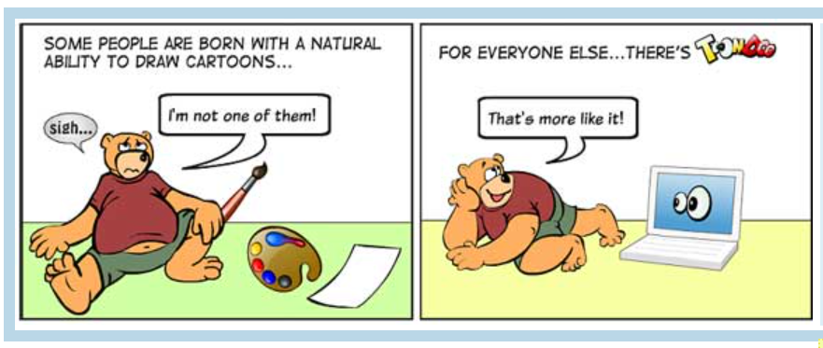
ToonDoo
Comic Strip Generator

Slide 24
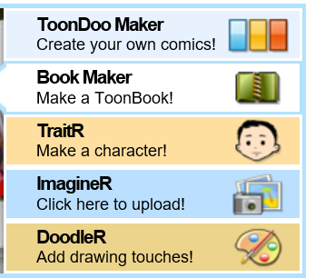

Slide 29
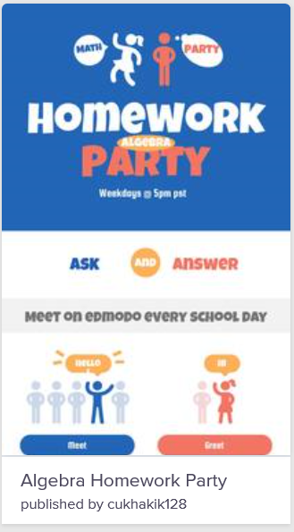
Piktochart
Web-based infographic application
Themed templates
Looks like you have graphic design experience
Viewable online

Slide 30
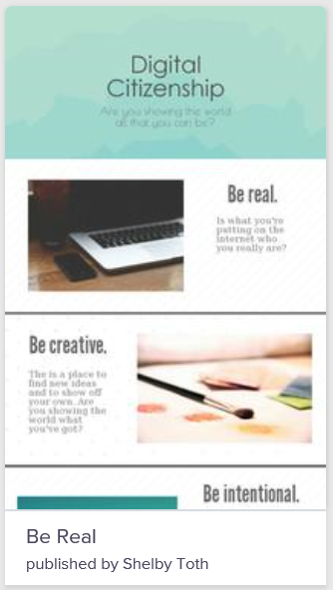
Tutorial
https://www.youtube.com/watch?v=Eq-85gzw3GI

Slide 32
Class Dojo
https://www.classdojo.com/about/
Free for teachers
Designed to
Create a positive culture
Give students a voice
Share moments with parents
Create a positive classroom culture
Share a digital high-five
Encourage classroom values
Give students a voice with digital portfolios
Student Stories
https://www.classdojo.com/studentstories/

Slide 33
Other Programs to Check Out
Podcasting
Vocaroo
Audacity
Video
Blabberize
You Tube editor
Screencastify
Movenote
Camtasia (not free)
Digital Bulletin Board
Padlet

Slide 34
Other Programs to Check Out
Virtual Reality
Aurasma
Mapping/Word Clouds
Realtime Board
PollEverywhere
Diffen
Popplet
Photo Editor
PicMonkey
Reminders
Remind 101

Slide 35
Other Programs to Check Out
Coding
Code.org
CS first (Google computer science clubs)
Study Games
Quizlet and Quizlet Live
Go Soap Box
PingPong
Kahoot
Quizizz
Let’s Recap
Spanish
Duolingo

Slide 36
Other Programs to Check Out
Storybooks/Comics
Textorizer
Novelty
Witty Comics
Artisan Cam
The Super Hero Squad
Pixton
Strip Generator
Piki Kids
Write Comics
Make Beliefs
Be Funky
Chogger

Slide 37
Other Programs to Check Out
Gamification
Gamestar Mechanic
Bloxels
Digital Compass
Win White House
Pixel Press Floors
Classroom Management Gamified
Classcraft
Class Badges

